Slide 1
B and B+ Trees
The efficient multi-way search trees
2026 January 7
G Roweena Siphora

Slide 2
Need of B and B+ trees
Reduced Tree Height
Efficient Disk Access
In a B-tree, each node can store multiple keys and have many children.
Because of this, the tree grows wide instead of tall.
A shorter tree means fewer levels to traverse during search.
Fewer levels = faster operations.
Disk access is much slower than memory access.
B-trees reduce the number of disk reads by keeping the tree height very small.
One node access can retrieve many keys at once
Faster Searching
Always Balanced
Since the height of the tree is minimized, keys are sorted within nodes.
Search operations take O(log n) time.
Even with millions of records, only a few node accesses are required.
This makes B-trees extremely fast for searching large amounts of data.
A B-tree automatically maintains balance by ensuring all leaf nodes remain at the same level.
During insertion and deletion, node splitting and merging prevent imbalance.
This guarantees consistent performance.
2

Slide 3
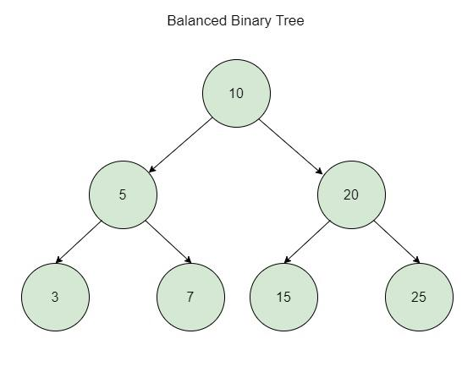
First of all, what is a Balanced tree??
Definition : A balanced tree is a tree data structure in which the height of the tree is kept minimal by ensuring that all leaf nodes are at the same level or the difference in heights of subtrees is within a defined limit, thereby guaranteeing efficient operations.
A balanced tree keeps its height minimal
Prevents growth in only one direction
Ensures efficient searching, insertion, and deletion
Guarantees logarithmic time complexity
Example: AVL trees, Red-Black trees, B and B+ trees
3

Slide 4
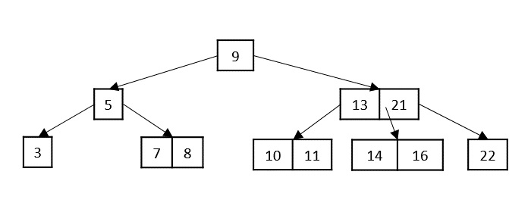
Say Hello to B trees
Definition : A B-tree is a self-balancing multi-way search tree in which each node can contain multiple keys and children, all keys are maintained in sorted order, and all leaf nodes appear at the same level.
Found by Rudolf Bayer.. So now we know B is Bayer
Designed for large data storage
Keys are stored in a sorted way.
all operations take O(log n) time
What are Multi-way search tree?
A multi-way search tree is a search tree in which each node can have more than two children and can store multiple keys.
“Multi-way” “Search”
Binary tree → max 2 children Keys are stored in sorted order
Multi-way tree → more than 2 children Tree follows search rules
Efficient searching like BST, but with many branches
What are the keys, then??
- Keys are the values stored in tree nodes that are used to compare, search, and decide the path to follow in the tree.
4

Slide 5
What is order of a B trees
The order of a B-tree, denoted by m, specifies how many children a node can have at most. It controls how wide the tree can grow.
Higher order → wider tree → smaller height.
Maximum children per node = m
Maximum keys per node = m − 1
Minimum children per node = ceil ⌈m / 2⌉
Minimum keys per node = ceil ⌈m / 2⌉ − 1
Example :
Order = 3 → max children = 3
max keys = 2
min children = 2
min keys = 1
To maintain balance, each internal node must have a minimum number of children. This prevents the tree from becoming sparse or skewed
5

Slide 6
Keys as Ranges
Keys divide values into ranges.
Each range maps to one child.
Keys are stored in sorted order.
Guide search and insertion.
In multi-way search trees, keys do not just store values; they divide the entire set of possible values into intervals.
Each key acts like a boundary that separates smaller values from larger ones.
Every range created by the keys corresponds to exactly one child node.
When a value is searched for or inserted, the tree checks which range the value falls into and follows that child.
6

Slide 7
Keys as Ranges
Method 1: Left-exclusive, Right-inclusive (Most commonly used)
Rule: Left side: < key
Right side: ≥ key
Example : [30 | 50]
Child Range
C0 values < 30
C1 30 ≤ values < 50
C2 values ≥ 50
Method 2: Left-inclusive, Right-exclusive (Also valid if used consistently)
Rule: Left side: ≤ key
Right side: > key
Example: [30 | 50]
Child Range
C0 values ≤ 30
C1 30 < values ≤ 50
C2 values > 50
7

Slide 8
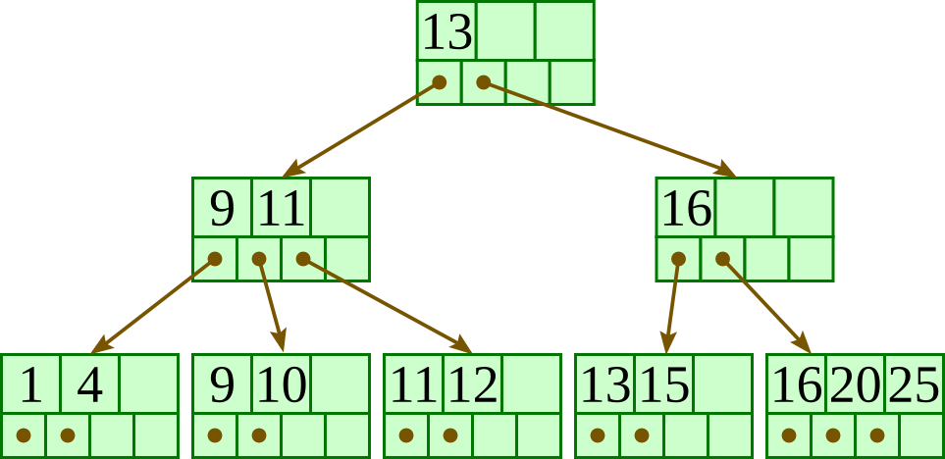
So, now what are B+ trees??
Definition: A B+ tree is an advanced form of B-tree in which all actual data records are stored only in the leaf nodes, internal nodes act as index structures, and leaf nodes are linked to support efficient sequential and range access.
Multi-way tree
Internal nodes → only keys
Leaf nodes → actual data
Leaves are linked
Example :
8

Slide 9
Advantages of B+ trees over B trees
In B+ trees, actual data records are stored only at the leaf level.
Internal nodes contain only keys used for navigation.
Since all data is at the leaf level, every search follows a uniform path length. This leads to predictable and often faster searches compared to B-trees, where data may be found at different levels.
Leaf nodes in a B+ tree are linked together in sorted order. Once the starting key is found, all values in the range can be accessed sequentially without traversing the tree again.
Because leaf nodes are linked like a linked list, B+ trees support efficient sequential traversal of records.
B+ trees are optimized for disk-based storage. Since internal nodes contain only keys, more keys fit into a disk block, reducing the number of disk accesses.
9

Slide 10
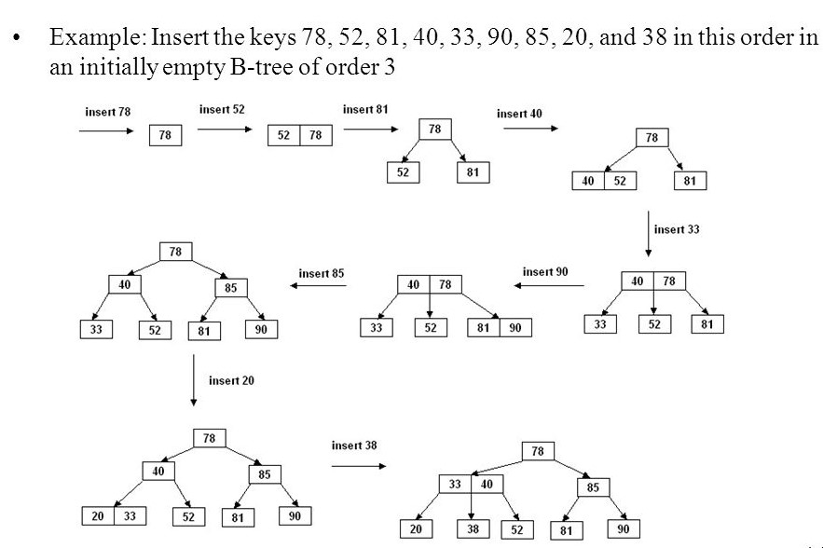
Inserting elements in a B tree
Insertion is always done at the leaf level.
Keys are inserted in sorted order.
Range-based traversal is used.
Overflow leads to node splitting.
Tree remains balanced automatically.
B-trees do not use balance factors or rotations like AVL trees. Instead, balance is maintained through splitting and promotion, ensuring that all leaf nodes remain at the same level.
10

Slide 11
Example: insertion of 30, 10, 50, 90, 70 with order 3
11

Slide 12
Example: insertion of 5, 3, 21, 9, 1, 13, 2, 7, 10, 12, 4, 8 with order 4
12

Slide 13
Inserting elements in a B+ tree
Start from the root
Traverse to the appropriate leaf
Insert key in sorted order
Check for overflow
Split the leaf node if required
Copy separator key to parent – my separator key is always the first key of my right node
Repeat splitting up the tree if needed
Create new root if root overflows
13

Slide 14
Example: insertion of 30, 10, 50, 90, 70 with order 3
14

Slide 15
Example: insertion of 1, 4, 7, 10, 17, 21, 31, 25, 19, 20, 28, 42 with order 4
15

Slide 16
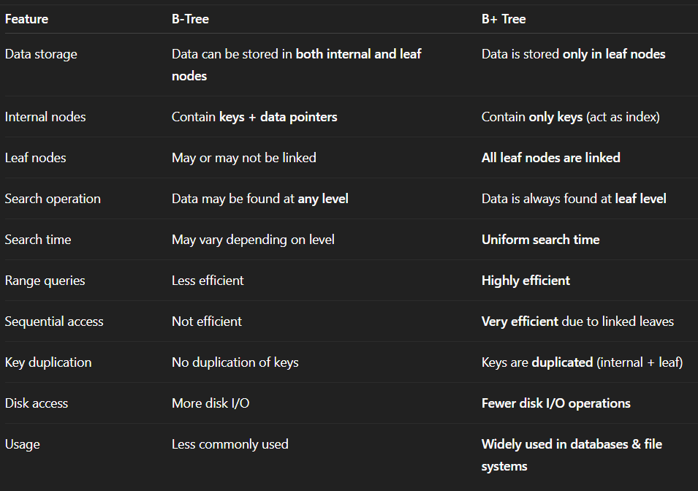
Difference between B and B+ trees
16

Slide 17
THE END
THANK YOU FOR LISTENING

